Slide 1
How to build an Industry Cost Profile (ICP) for a product in The Netherlands
Identify industry code based on the supplier’s business and product
Step 2
Identify data sources for financial and manufacturing information related to industry code
Step 3
Step 1
Use industry data to calculate ratios for DM, DL, MOH, COGS, GSA & PBT

Slide 2
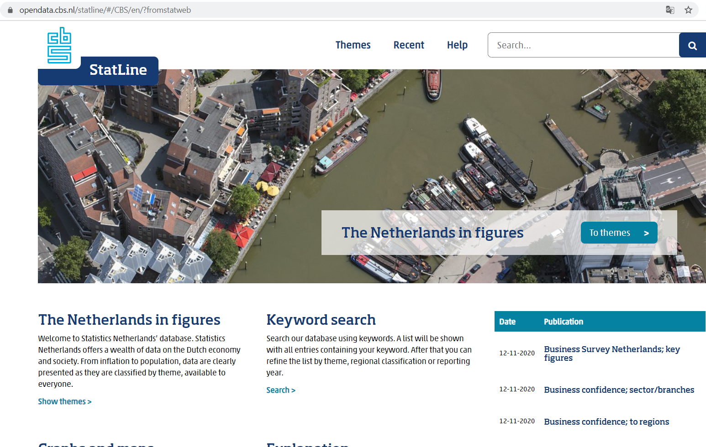
Identify Industry & obtain Financial and Manufacturing Information Related to Industry.
Step 2
Go to
Click on “Themes”
http://statline.cbs.nl/statweb/?LA=en

Slide 3
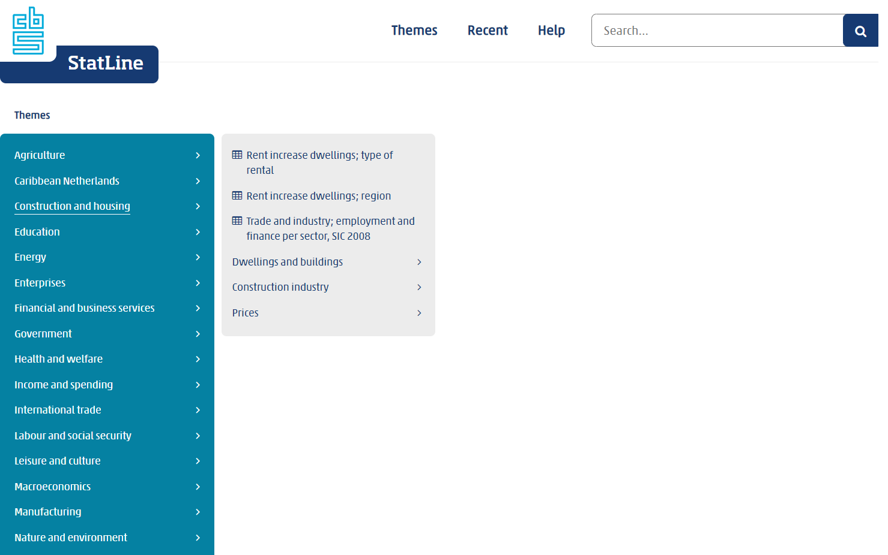
Identify Industry & obtain Financial and Manufacturing Information Related to Industry.
Step 2
Click on the Industry of interest.
In our example it is “Construction and housing”.
Then click on “Trade and industry; finance, SIC 2008

Slide 4
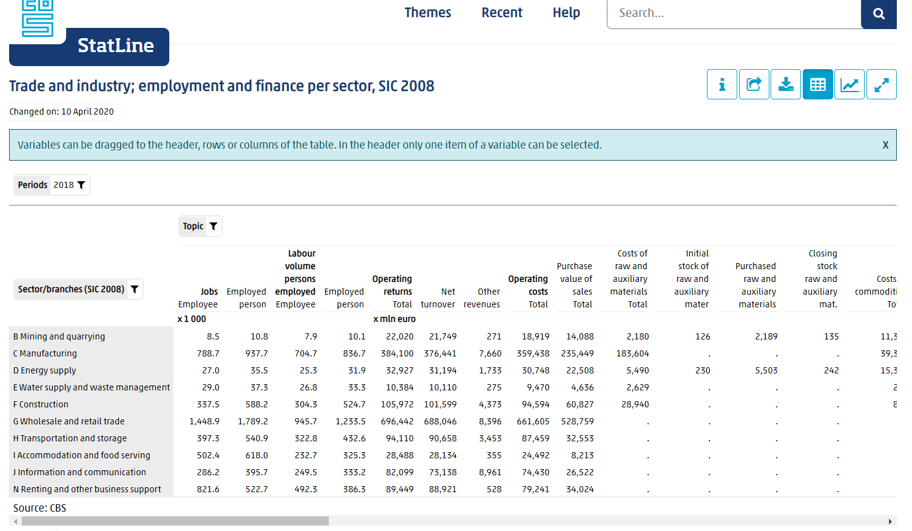
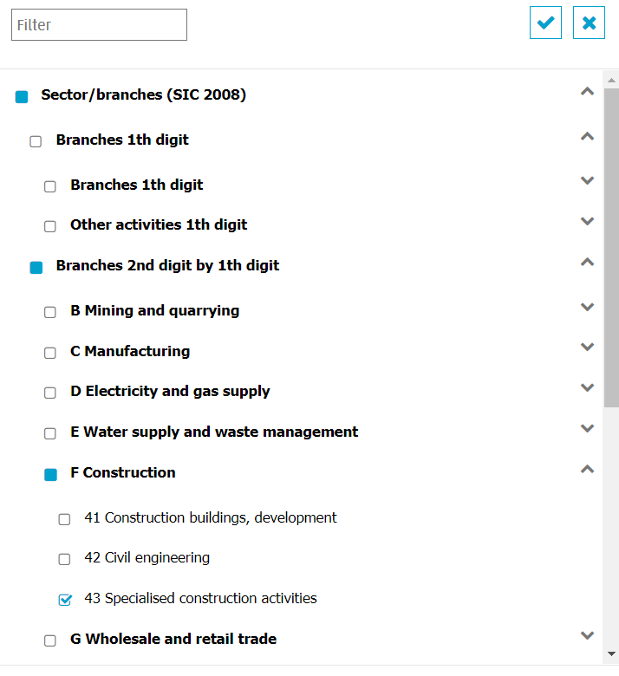
Identify Industry & obtain Financial and Manufacturing Information Related to Industry.
Step 2
Click on the filter sign next to ‘Sector/branches (SIC 2008)’
Uncheck the ‘Sector/branches (SIC 2008)’ selection
Under ‘Branches 2nd digit by 1th digit’ select ‘F Construction’ and from the subsequent dropdown select ’43 Specialised construction activities’

Slide 5
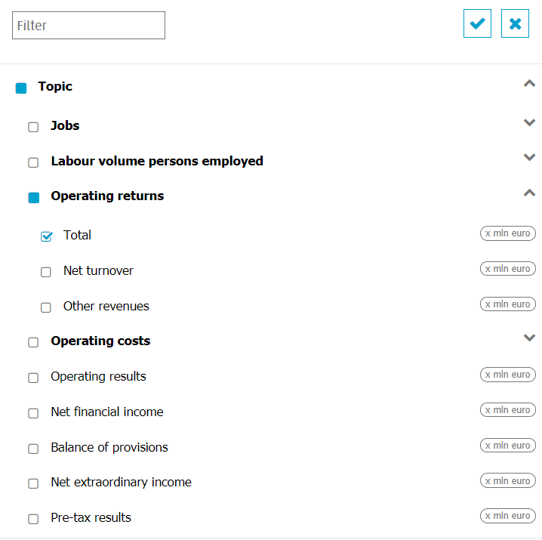
Identify Industry & obtain Financial and Manufacturing Information Related to Industry.
Step 2
Click on the filter sign next to ‘Topic’.
Uncheck the ‘Topic’ Selection and manually select the following cost heads:
Select ‘Operating returns’ and from the subsequent drop down under it select ‘Total’

Slide 6
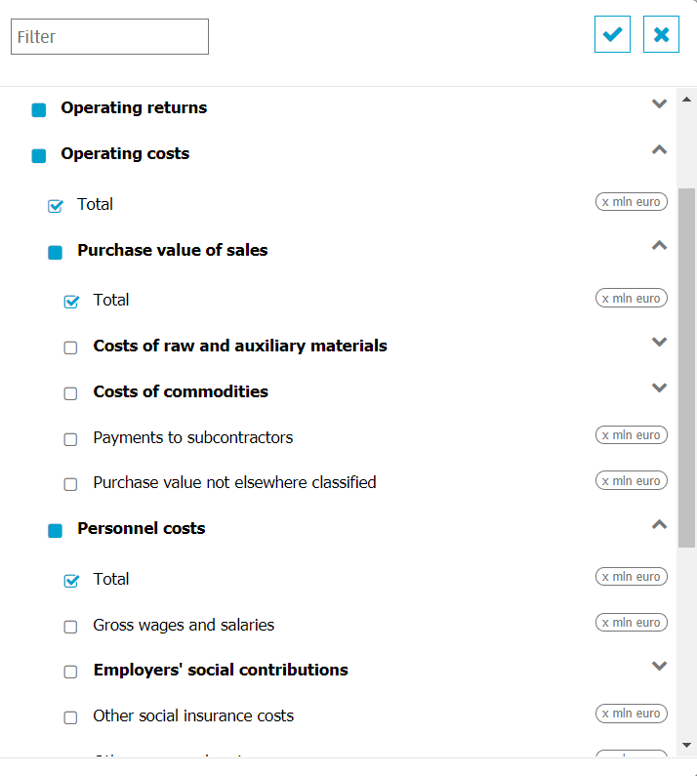
Identify Industry & obtain Financial and Manufacturing Information Related to Industry.
Step 2
Select ‘Operating costs’ and from the subsequent drop down select ‘Total’ and unselect the rest
Select ‘Purchase Value of Sales’ and from the subsequent drop down select ‘Total’ and unselect the rest
Select ‘Personnel costs’ and from the subsequent drop down select ‘Total’ and unselect the rest

Slide 7
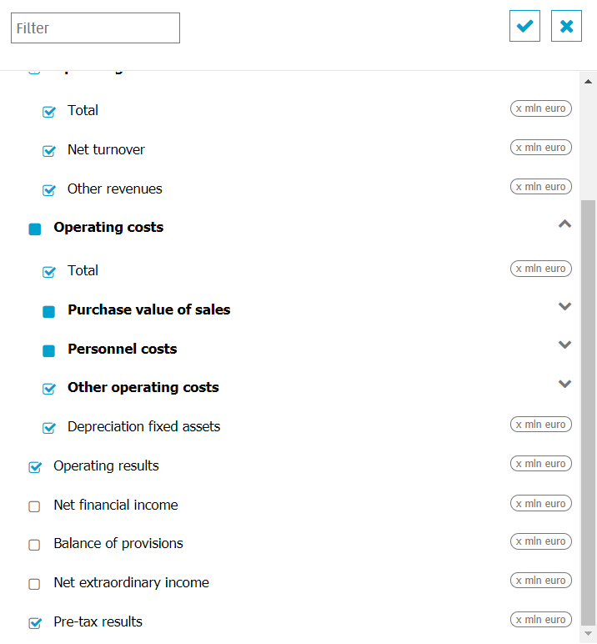
Identify Industry & obtain Financial and Manufacturing Information Related to Industry.
Step 2
Select ‘Other operating costs’ and from the subsequent drop down select all
Select ‘Depreciation fixed assets’
Select ‘Operating results’
Select ‘Pre tax results’

Slide 8
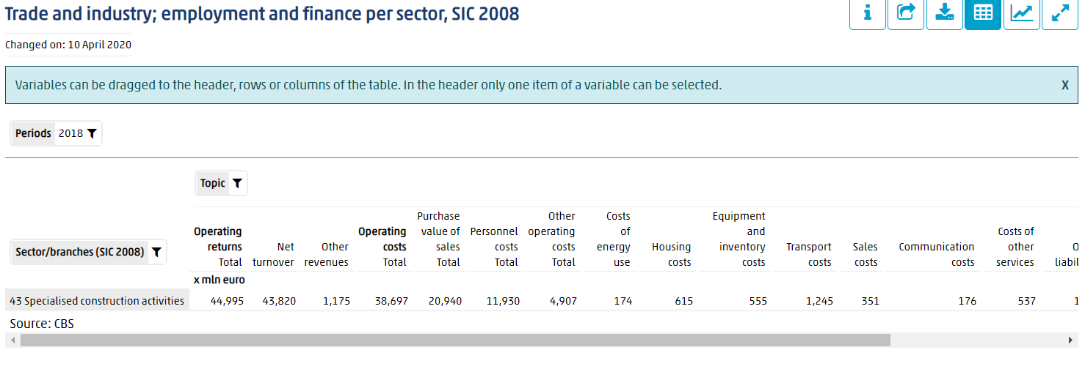
Identify Industry & obtain Financial and Manufacturing Information Related to Industry.
Step 2
Record the following values:
1. Total Revenue under Operating returns.
2. Purchase value of sales
3. Personnel costs Total
4. Costs of energy use
5. Housing costs
6. Equipment and inventory costs.
7. Transport costs.
8. Sales costs
9. Communication costs
10. Costs of other services

Slide 9
Identify Industry & obtain Financial and Manufacturing Information Related to Industry.
Step 2
Record the following values:
11. Other liabilities
12 Depreciation fixed assets
13 Pre-tax result

Slide 10
Use Financial and Manufacturing Information to Calculate Ratios
Step 3
1.. Calculate the Direct Material (DM) ratio as percentage of sales
2. Calculate Total Labour ratio as percentage of sales/revenue
 | Purchase value of sales (DM) | 20,940
 | Operating returns Total | 44,995
 | Direct Material (DM) | 46.5%
 | Personnel Costs Total | 11,930
 | Operating returns Total | 44,995
 | Total Labor (TL) | 26.5%
1.
2.

Slide 11
Use Financial and Manufacturing Information to Calculate Ratios
Step 3
3. Use the below assumptions to calculate DL, Indirect Labor to SOH & Indirect Labor to SGA
Anklesaria assumption :-
1. DL/TL=70%
2. 10% of Indirect labour contributes to Service Overhead (SOH)
3. 90% of Indirect labour contributes to Selling, general & Administrative (SGA) expenses.
 | Total Labor | 26.5%
 | Direct Labor (DL) | =0.70*26.5
 | Direct Labor (DL) | 18.6%
 | Indirect Labor to SOH | =0.10*(26.5-18.6)
 | Indirect Labor to SOH | 0.8%
 | Indirect Labor to SGA | =0.90*(26.5-18.6)
 | Indirect Labor to SGA | 7.2%
3.
Notes:
Korea-
Basic Metal Manufacturing
COGS 116,108,609
DM 79,607,506
DM/COGS=68%

Slide 12
Use Financial and Manufacturing Information to Calculate Ratios
Step 3
4. Calculate Service Overhead (SOH)
5.
 | Costs of energy use | 174
 | Housing costs | 615
 | Equipment and inventory costs | 555
 | Transport costs | 1245
 | Depreciation fixed assets | 920
 | Operational Cost | 3,509
 | Operating returns Total | 44,995
 | Operational Cost | 7.8%
 | Indirect Labor to SOH | 0.8%
 | Operational Cost | 7.8%
 | Service Overhead (SOH) | 8.6%
SOH = Indirect Labor to SOH + Energy costs + Housing cost + Equipment & inventory costs + transport costs + Depreciations fixed assets)
6.
7.

Slide 13
Use Financial and Manufacturing Information to Calculate Ratios
Step 3
5. Calculate SGA
5.
 | Sales costs | 351
 | Communication costs | 176
 | Costs of other services | 537
 | Other liabilities | 1,253
 | Total | 2,317
 | Operating returns Total | 44,995
 | SGA | 5.1%
 | Indirect Labor to SGA | 7.2%
 | SGA | 5.1%
 | Total SGA | 12.3%
SGA = Indirect Labor to SGA +Sales costs+
Communication costs+
Costs of other services+
Other liabilities)
6.
7.

Slide 14
Use Financial and Manufacturing Information to Calculate Ratios
Step 3
Steps: 5 - 6
5. Calculate Profit Before Tax (PBT) Cost Of Goods Sold
5.
 | DL | 18.6
 | DM | 46.5
 | SOH | 8.6
 | SGA | 12.3
 | Total | 86.0
 | PBT | =100-86
 | PBT | 14.0%
PBT = 100- SGA-SOH-DL- DM
6.

Slide 15
Present all your calculated ratios in the cost breakdown format
Industry cost profile for “43 Specialised construction activities”
 | Direct Material (DM) | 46.5%
 | Direct Labor (DL) | 18.6%
 | Service Overhead (SOH) | 8.6%
 | Cost of Goods Sold (COGS) | 73.7%
 | SGA & Other Expenses | 12.3%
 | Profit Before Tax (PBT) | 14.0%
 | Total Sales | 100.0%
Ratios calculated from ”Statistics Netherlands”

